Slide 1
Left is Right "Left" is either "Right" or "Right" in our game. An interesting and challenging mind/word game played with Bose Frames Rondo that brightens your day and refreshes your mind.
Team Members
Sabhari Natarajan
Surya Murugavel Ravishankar
Vadhurshan Thangaraj

Slide 2
Inspiration and Goals
Inspiration
Goals
Big Fish/Small Fish
Actions – Hand
Confusion – Flipped, Organizer’s actions
Our Game
Actions – Head
Confusion – Flipped, More complex
To create a fun yet competitive game that tests your reflexes
To eliminate the need of visual feedback to play the game.
To provide exercise to the player’s neck

Slide 3
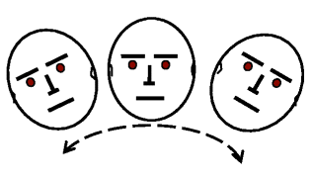
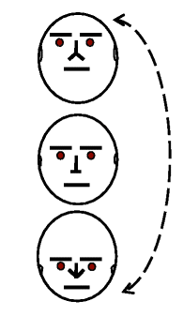
Instructions
Rules
You will hear 4 commands “Left”, “Right”, “Front” or “Back”. Tilt you head in the appropriate direction and stay there until the next command.
If you hear “Left and Right Flipped” you tilt left, if you hear right and tilt right, if you hear left.
The current direction should be flipped with respect to the previous level. Example: If you hear “Left and Right Flipped” in level 1 and “Left and Right Flipped” in level 2, you will now tilt right if you hear right and tilt left if you hear left.
The speed of response increases each level.
Scores
You gain scores according to the level you are in.
You lose a life each time you go wrong.
If you complete a level with perfect score you get a bonus life.
The game is over when all lives are lost.
You can use hint to see the current state(if left/right or front/back is flipped or not) at any level but you lose 100 points.
You win if you complete level 16.
Left/Right
Front/Back

Slide 4
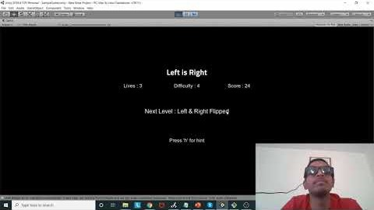
Demo Video

Slide 5
Future Scope
One of the additions would be to exploit the stereo speaker and have spatial sounds which will add to the confusion.
The flipping pairs can be changed from not just left-right & front-back to other combinations like front-left etc.
A memory game, where the direction to be followed will be listed out and the player has to remember it and then follow the sequence. Ex, If Left-Right-Back-Front is the sequence, then the player has to tilt his head accordingly.
Even further, the flipping commands can be added to the memory game.
Another addition would be, adding direction like 'left-front', 'back-right' etc, instead of just left, right, front & back.
Can be converted to Android/IOS game.

Slide 6
Thank You

